Slide 1

Cardiovascular Disease
By Ori rinaman

Slide 2
Introduction
Cardiovascular disease is the number one cause of death globally. The World Health Organization (WHO) states that cardiovascular disease takes an estimated 17.9 million lives each year which accounts for 31% of all deaths worldwide. My exploratory data analysis is going to explore certain variables in the data set to determine if they can predict if someone will die from cardiovascular disease.

Slide 3
Research Questions to Investigate
Using the data provided, can I accurately predict if someone with cardiovascular disease will die?
*I will note that I did put a lot of focus on how variables interreacted with the platelet's variable. Platelets are the cells that circulate within our blood and bind together when they recognize damaged blood vessels. Platelet count is usually a good indicator of the health of someone.

Slide 4
Variables
There are 6 main variables that I plan to focus on for this exploratory data analysis…
age: The age of the patient
platelets: platelets in the blood
high_blood_pressure: Does the person have high blood pressure (yes/no)
sex: Sex of the person
smoking: Is the person a smoker (yes/no)
DEATH_EVENT: did the person die

Slide 5
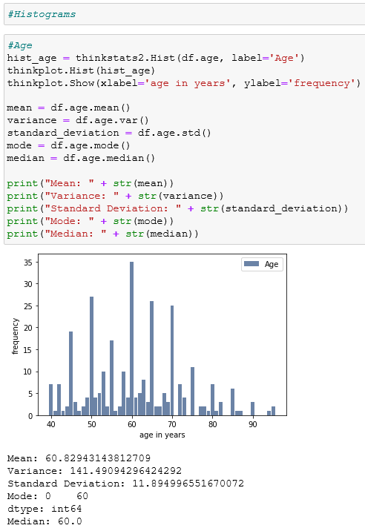
Age
The age variable is normally distributed. We can make this assumption by looking at the mean and median. Both these summary statistics are approximately the same so we can conclude that the distribution is normal.

Slide 6
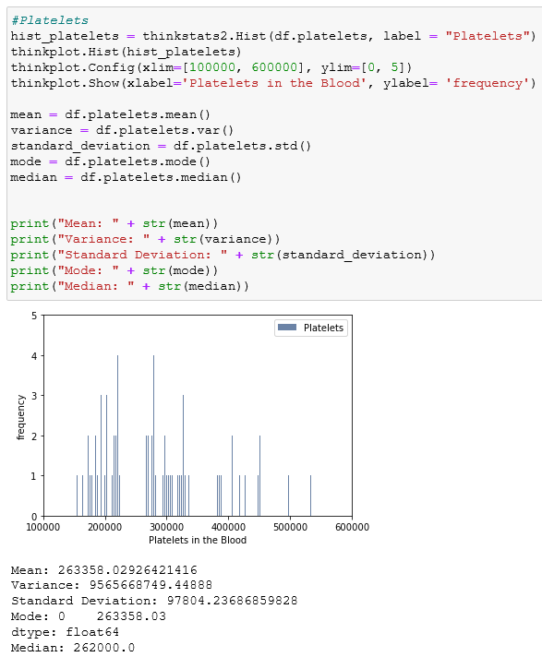
Platelets
The platelets variables is skewed right. We can make this assumption because the median is slightly lower than the mean. We can also visually see the skew to the right of the histogram.

Slide 7
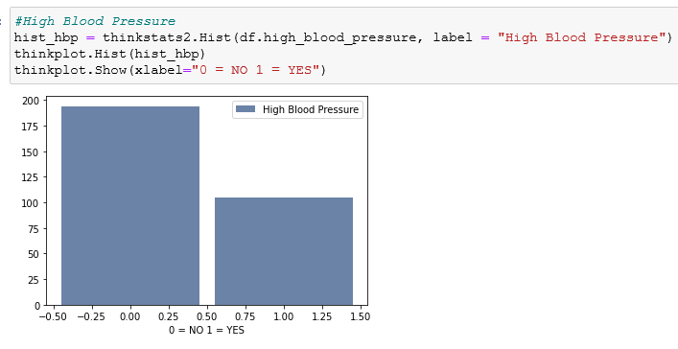
High_Blood_Pressure
This variable surprised me when I started my investigation. I originally assumed that since all the people in the data set have cardiovascular disease, that most of them would have high blood pressure. To my surprise my original assumption was incorrect. We can see that the data set has more people without high blood pressure than with high blood pressure.

Slide 8
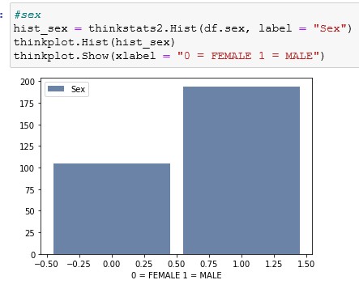
Sex
When looking at sex, we can see that the data set contains more males than females.

Slide 9
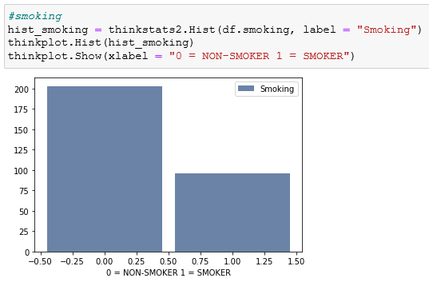
Smoking
The smoking variable was another variable that shocked me. I thought that there would be more smokers than non-smokers, but I once again made an incorrect assumption about a variable.

Slide 10
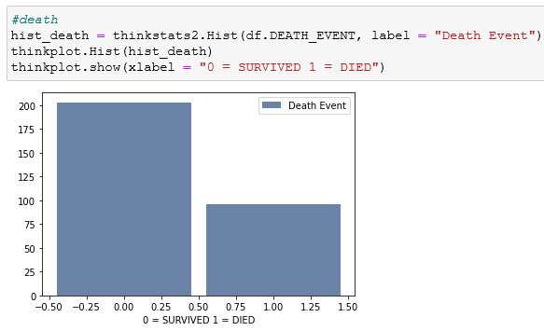
DEATH_EVENT
Discussing death is never a positive topic, but it is good to see that more people survived than died from cardiovascular disease in the data set. This will be the variable I will be looking to predict in the upcoming slides.

Slide 11
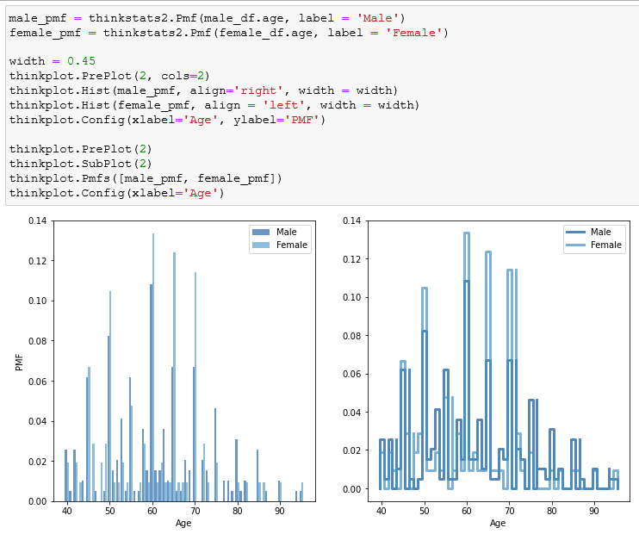
Probability Mass Function (PMF) of Age by Sex
The probability mass function (PMF) is another was to represent a distribution. It maps each value to a specific probability. Here, I wanted to see the distribution of the age and sex of the people in the data set to see if there were any patterns or distinct differences. What I noticed that was strange is that there are four ages (60, 65, 70, 71) where females tend to have more observations than males. Since the data is a sample from a larger population, it would be something I would like to investigate.

Slide 12
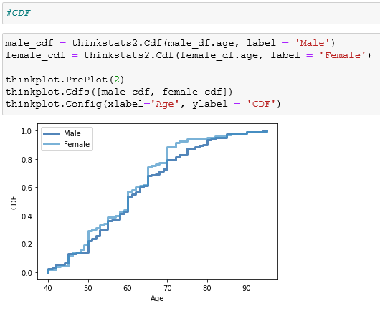
Cumulative Distribution Function (CDF)
The cumulative distribution function (CDF) is a function that maps from a value to its percentile rank. The CDF is a function of x where x is any value that might appear in the distribution. Surprisingly, we can see that females tend to be slightly younger than males throughout the distribution.

Slide 13
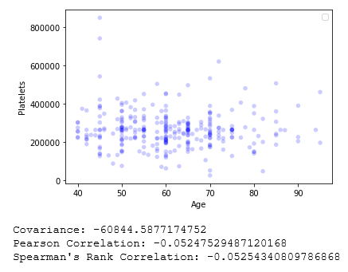
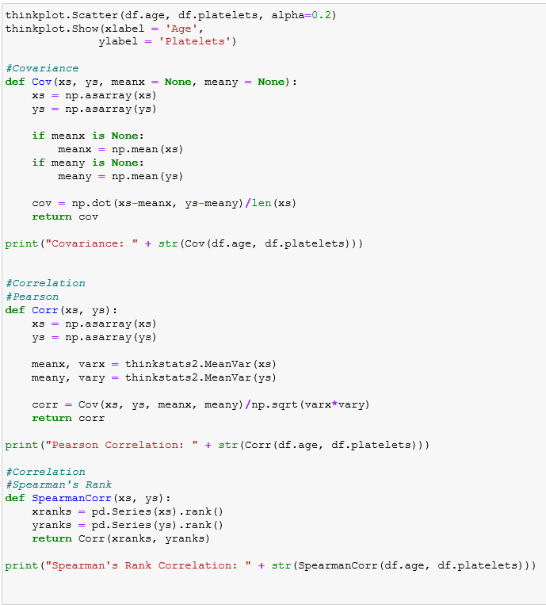
Platelet Count vs. Age
I wanted to see if there was any relationship between platelet count and age of observed people. The covariance was -60844 which signifies that there is a negative relationship between the two variables. The negative relationship means that as age increases, the count of platelets will decrease. Covariance only tells us of the direction of the relationship and not the strength. To find the strength of the relationship, we use the Pearson Correlation Coefficient. This coefficient shows that the correlation between the two is small. We also got similar results from the Spearman’s Rank Correlation Coefficient.

Slide 14
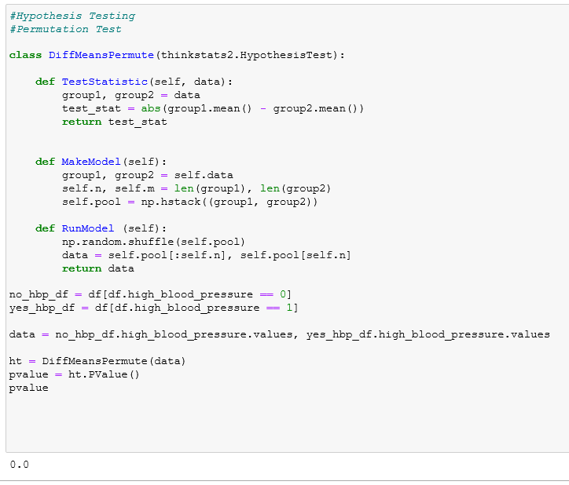
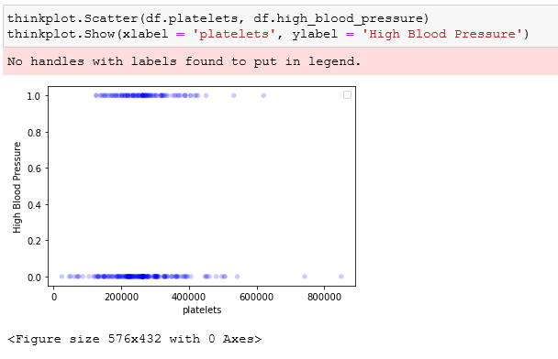
Platelet Count vs. High Blood Pressure
Since I discovered there is a slight correlation of platelets with age, is there any significant difference between platelet count and if someone has high blood pressure? To attack this question, I created a scatterplot of platelets and the variable high_blood_pressure. We can see how the values are spread out over someone who has or does not have high blood pressure. To see if there is a difference between platelet counts and if someone has high blood pressure, I decided compute a difference in means test. The null hypothesis would be that there is no difference between the means and the alternative hypothesis would be that there is a difference in means. The resulting p-value that we computed was 0.00. this is below our significance level of 0.05 so we can reject the null an assume that the two means are in fact statistically different and there is a difference in platelet count for people with and without high blood pressure.

Slide 15
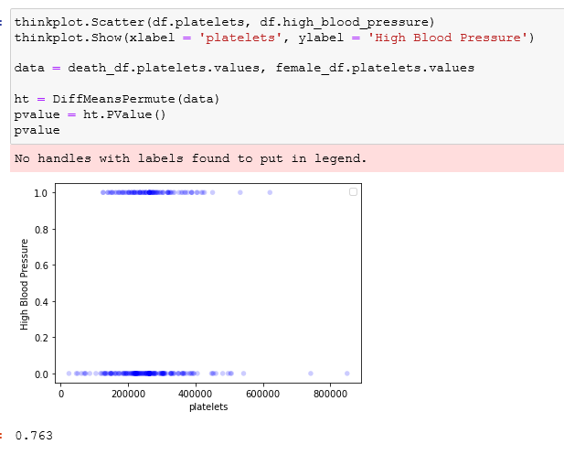
Platelet Count vs. Death Event
Since I had put so much focus on platelet count, now I wanted to see how it responded when I made a comparison with the variable death event. For this I also wanted to conduct a difference in means test. The null hypothesis is that there is no difference in means between if someone died or survived, and the alternative is that there is a difference in means between if someone survived or died. The p-value came out to 0.763, which is way above our significance level of 0.05 so we can conclude that statistically that there is no difference in platelet counts and if someone survived or died from cardiovascular disease.

Slide 16
Logistic Regression Model
Now that I had a decent feel of the variables in the data set and how they all relate to each other, I know set my sights on seeing if I could create a regression model to predict a death event using the variables mentioned throughout this EDA. Since the variable that I am trying to predict is boolean I decided to use logistic regression. Logistic Regression returns values as odds in favor of an event occurring. In this instance the event we are looking at is a death event or when the DEATH_EVENT variable == 1.

Slide 17
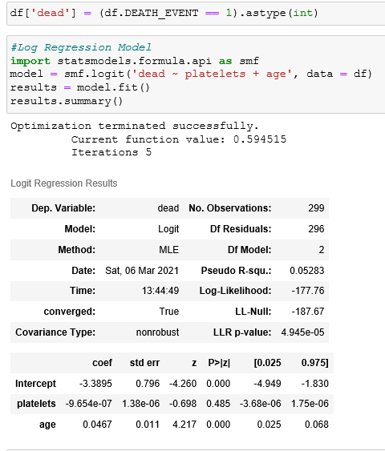
Logistic Regression Model cont.
Now as we have learned throughout the semester there are numerous techniques for choosing variables for the model. I conducted the stepwise technique to choose my variables. The stepwise technique starts with all the variables in the original model. Then you remove the predictor with the highest p-value. Next you repeat and stop when all variables left are significant. Unfortunately, I was only left age and platelets. These were the only to variables that were significant to the model. The R^2 value was very low at only 0.05, which means that the two variables age, and platelets only explain 5% of the total variation.

Slide 18
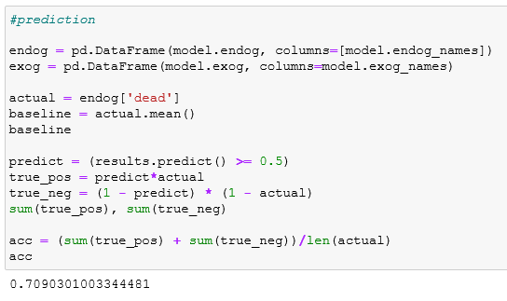
Logistic Regression Model cont.
Even though my model produced a very small R^2 value, I decided to see how well it could predict if someone was to have a death event or not. To my surprise the model predicted ~71% of the events correctly.

Slide 19
Final thoughts…
Finally, the EDA is complete and there were some interesting insights that I discovered from the data. One of the most surprising is that Females tend to experience cardiovascular disease at a younger level than males in the data frame. This is shocking because all the data that I researched stated the opposite. What also was interesting is that there was a small negative correlation between age and platelet count. So as a person gets older, their count of platelets slowly decreases. This was a fun analysis to conduct, even though the results were not what I had expected. My 71% accuracy with my logistic regression model was not the best but surprising considering it only needed two variables.

